Slide 1
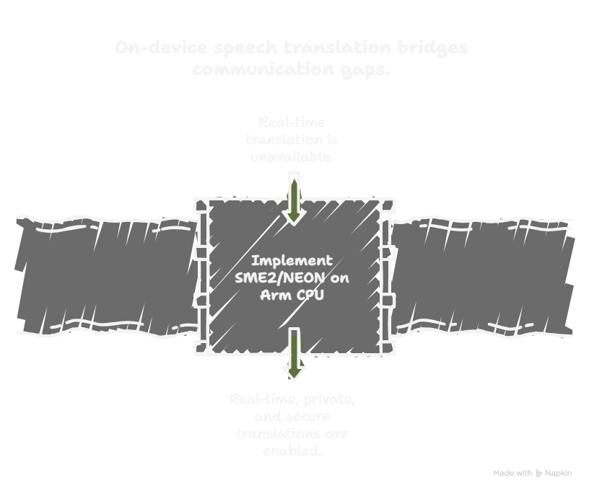
Bharat AI-SoC Student
Challenge:
PROBLEM STATEMENT 4 -
Real-Time On-Device Speech-to-Speech Translation using SME2 and/or NEON on Arm CPU
TEAM MEMBERS -
Tufan Layek (RA2411004010209)
Protyay Saha (RA2411004010196)
Rounack Sarkar (RA2411004010381)
UNIVERSITY -
SRM INSTITUTE OF SCIENCE AND TECHNOLOGY
MENTOR NAME -
Dr. Haroonhaider H. Sidhwa
Notes:
Good morning everyone.
For Problem Statement 4, we developed VoxBridge, a fully offline, real-time speech-to-speech translation system designed to run on Arm-based CPUs.

Slide 2
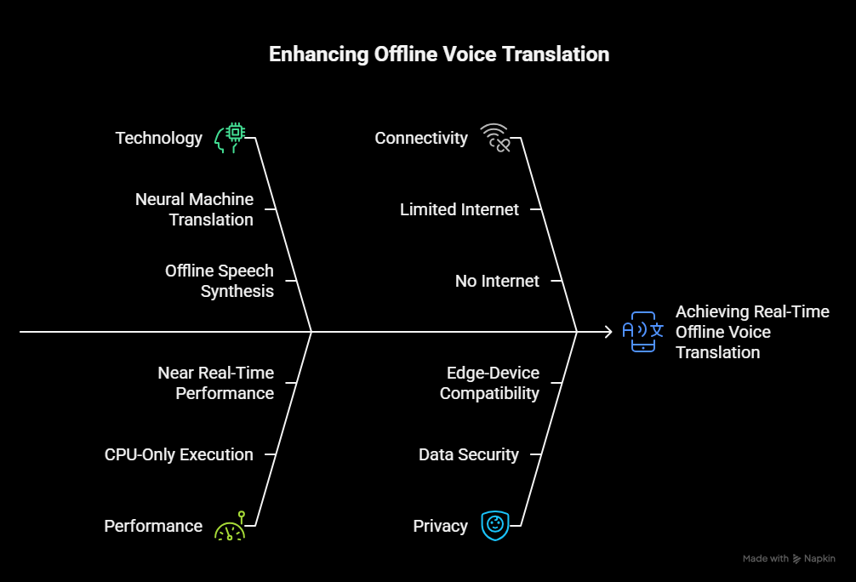
Abstract
VoxBridge is a fully offline, real-time multilingual AI voice translation system
Designed for environments with limited or no internet connectivity
Integrates:
Automatic language detection
Silence-aware processing
Neural machine translation
Offline speech synthesis
Achieves near real-time performance using CPU-only execution
Ensures privacy, low latency, and edge-device compatibility
Notes:
Our system listens to spoken audio in one language, converts it to text using an on-device speech recognition model, translates it using a compact transformer-based model, and then speaks the translated output using offline text-to-speech. Everything runs locally — no cloud, no internet, and no external servers.
We focused on using lightweight and efficient models so that the system can run smoothly on CPU while maintaining low latency and stable performance. We tested our implementation on an Apple Silicon M4 device, which is based on Arm architecture, demonstrating that real-time translation is possible directly on-device.
This approach ensures privacy, reliability, and suitability for edge environments where internet access may not be available.
Now, we will demonstrate the complete offline speech-to-speech translation pipeline.

Slide 3
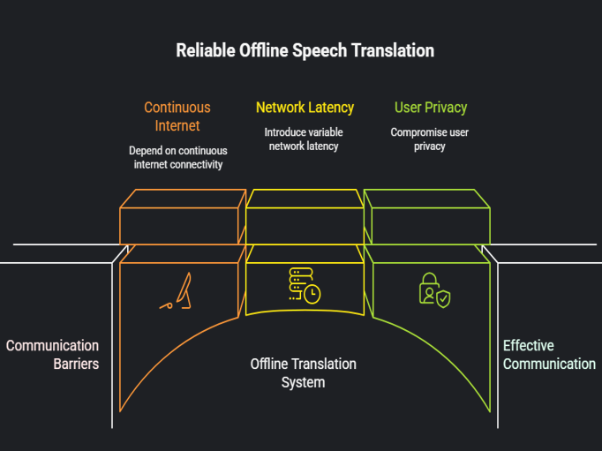
Problem Statement :
Language barriers hinder effective communication in:
Healthcare
Education
Travel
Emergency situations
Existing solutions:
Depend on continuous internet connectivity
Introduce variable network latency
Compromise user privacy
There is a need for a reliable offline speech-to-speech translation system

Slide 4
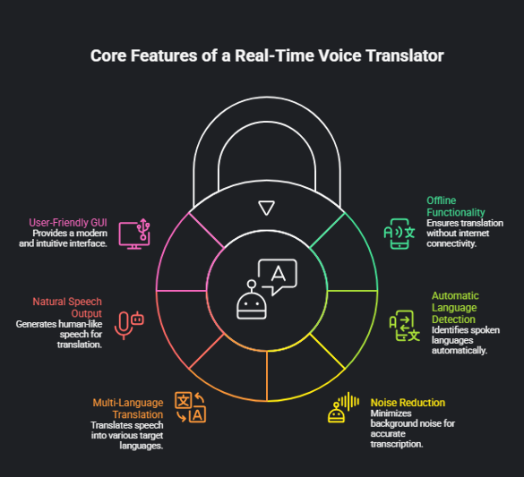
Objectives :
Develop a fully offline real-time voice translator
Enable automatic spoken language detection
Reduce background noise for accurate transcription
Translate speech into multiple target languages
Generate natural-sounding speech output
Provide a modern, user-friendly GUI

Slide 5
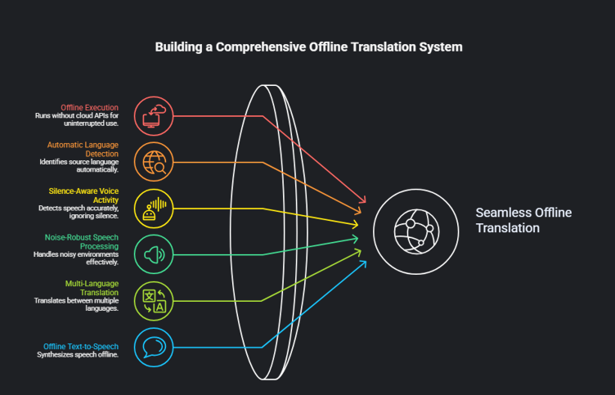
Key Features :
Fully offline execution (no cloud APIs)
Automatic source language detection
Silence-aware voice activity detection
Noise-robust speech processing
Multi-language neural translation
Offline text-to-speech synthesis
Real-time latency display
Dark / Light mode GUI
CPU-based execution (no GPU required)

Slide 6
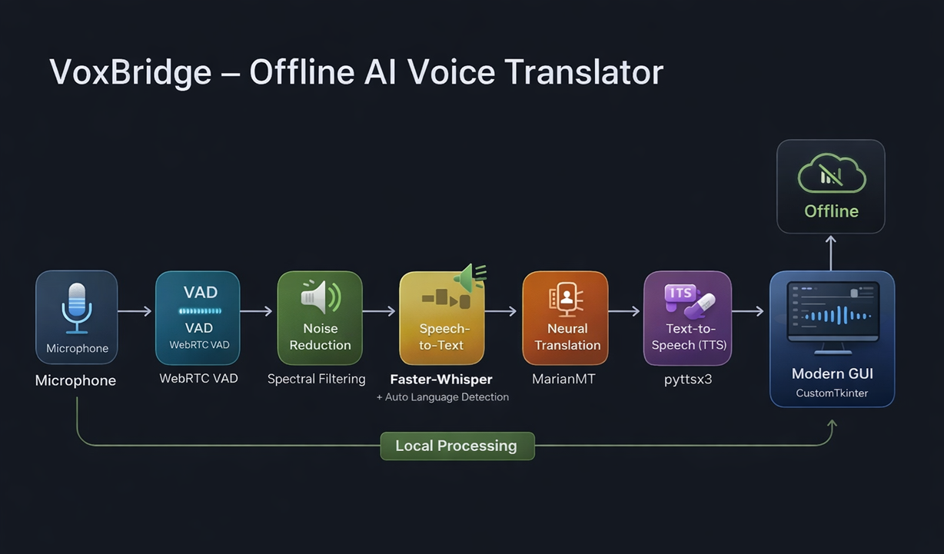
SYSTEM ARCHITECTURE :

Slide 7
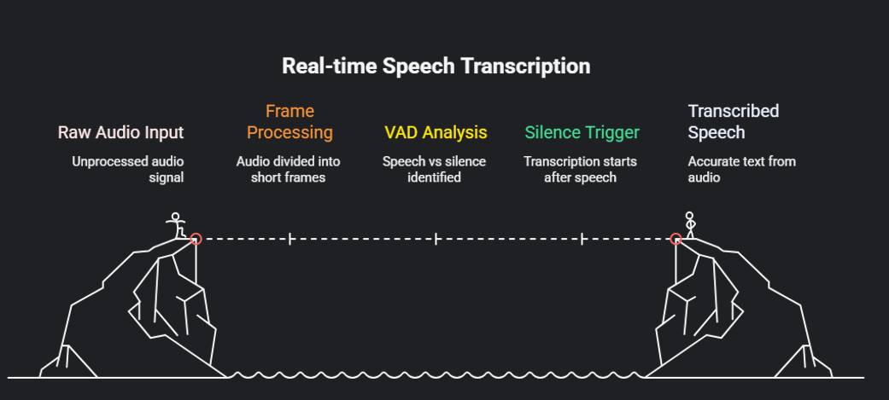
Audio Acquisition & VAD :

Slide 8
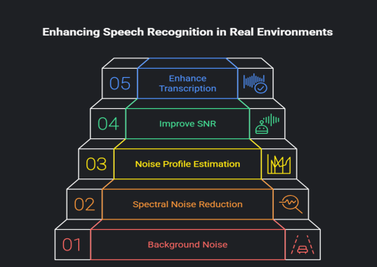
Noise Reduction Module :
Background noise affects speech recognition accuracy
Spectral noise reduction applied to speech segments
Noise profile estimated from non-speech frames
Improves Signal-to-Noise Ratio (SNR)
Enhances transcription performance in real environments

Slide 9
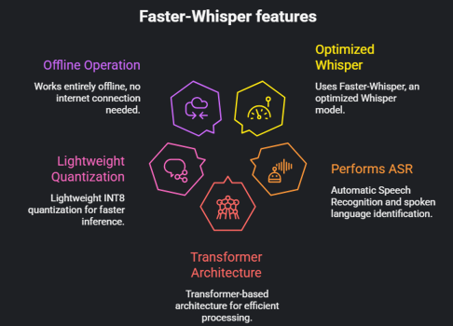
SPEECH-TO-TEXT & LANGUAGE DETECTION :
Uses Faster-Whisper, an optimized Whisper model
Performs:
Automatic Speech Recognition (ASR)
Spoken language identification
Transformer-based architecture
Lightweight INT8 quantization for faster inference
Works entirely offline

Slide 10
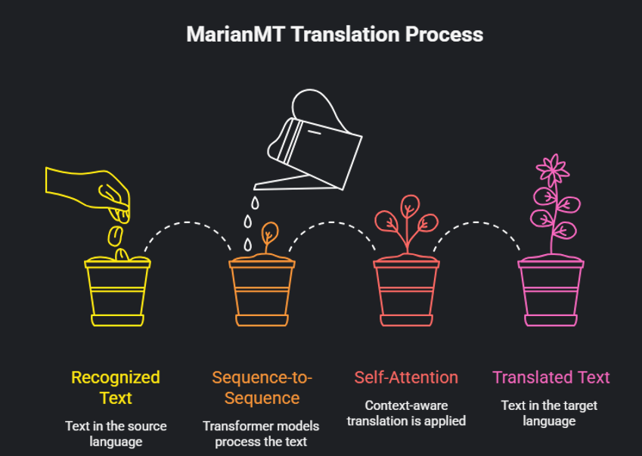
Neural Machine Translation :

Slide 11
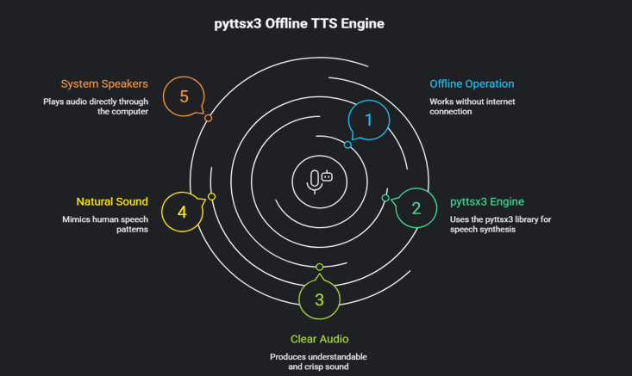
Offline Text-To-Speech(TTS):
Translated text converted into speech
Uses pyttsx3 offline TTS engine
No external API or internet required
Generates clear and natural audio output
Output played directly through system speakers

Slide 12
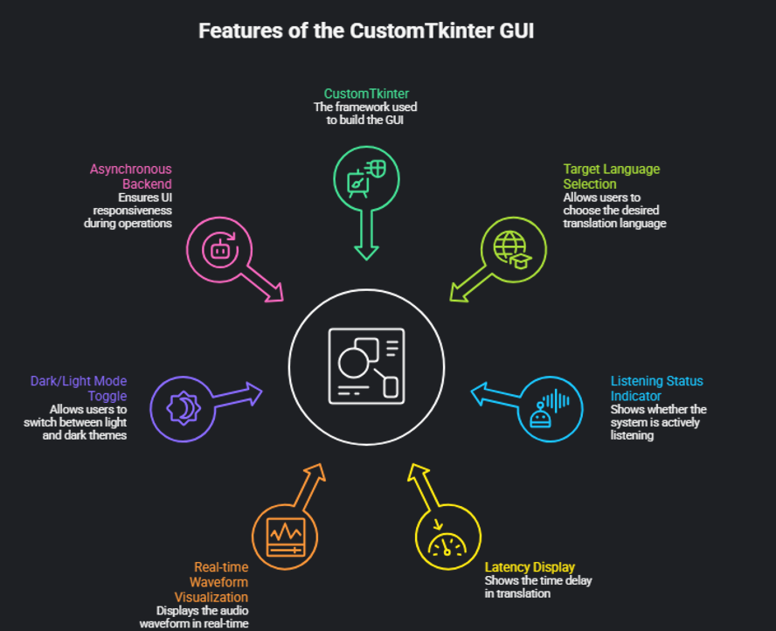

Slide 13
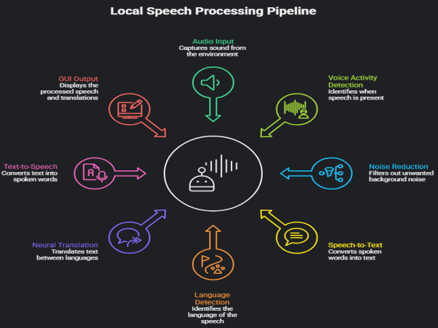
End-To-End Data Flow :
Audio Input
Voice Activity Detection
Noise Reduction
Speech-to-Text + Language Detection
Neural Translation
Text-to-Speech
GUI Output
Entire processing pipeline runs locally
No cloud communication involved

Slide 14
Performance Benchmark :
Processing Stage | Average Latency
Speech Recognition | 300–800 ms
Translation | 200–400 ms
Text-to-Speech | 100–200 ms
End-to-End | ~1 second
Execution Mode: CPU-only
Internet Required: No

Slide 15
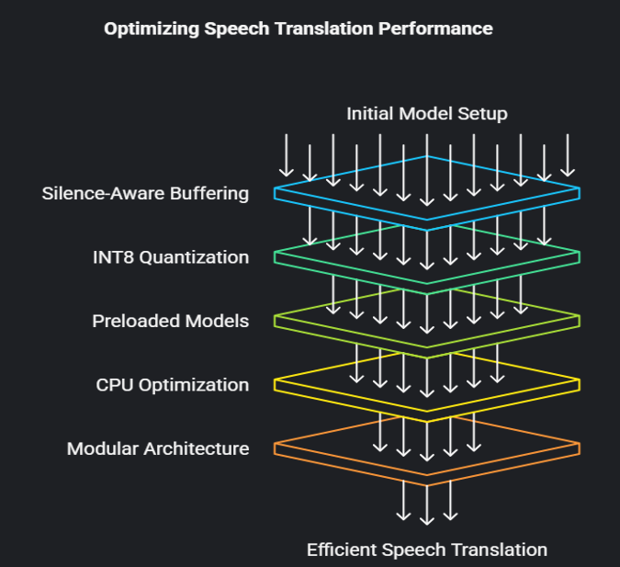
Optimization Techniques:

Slide 16
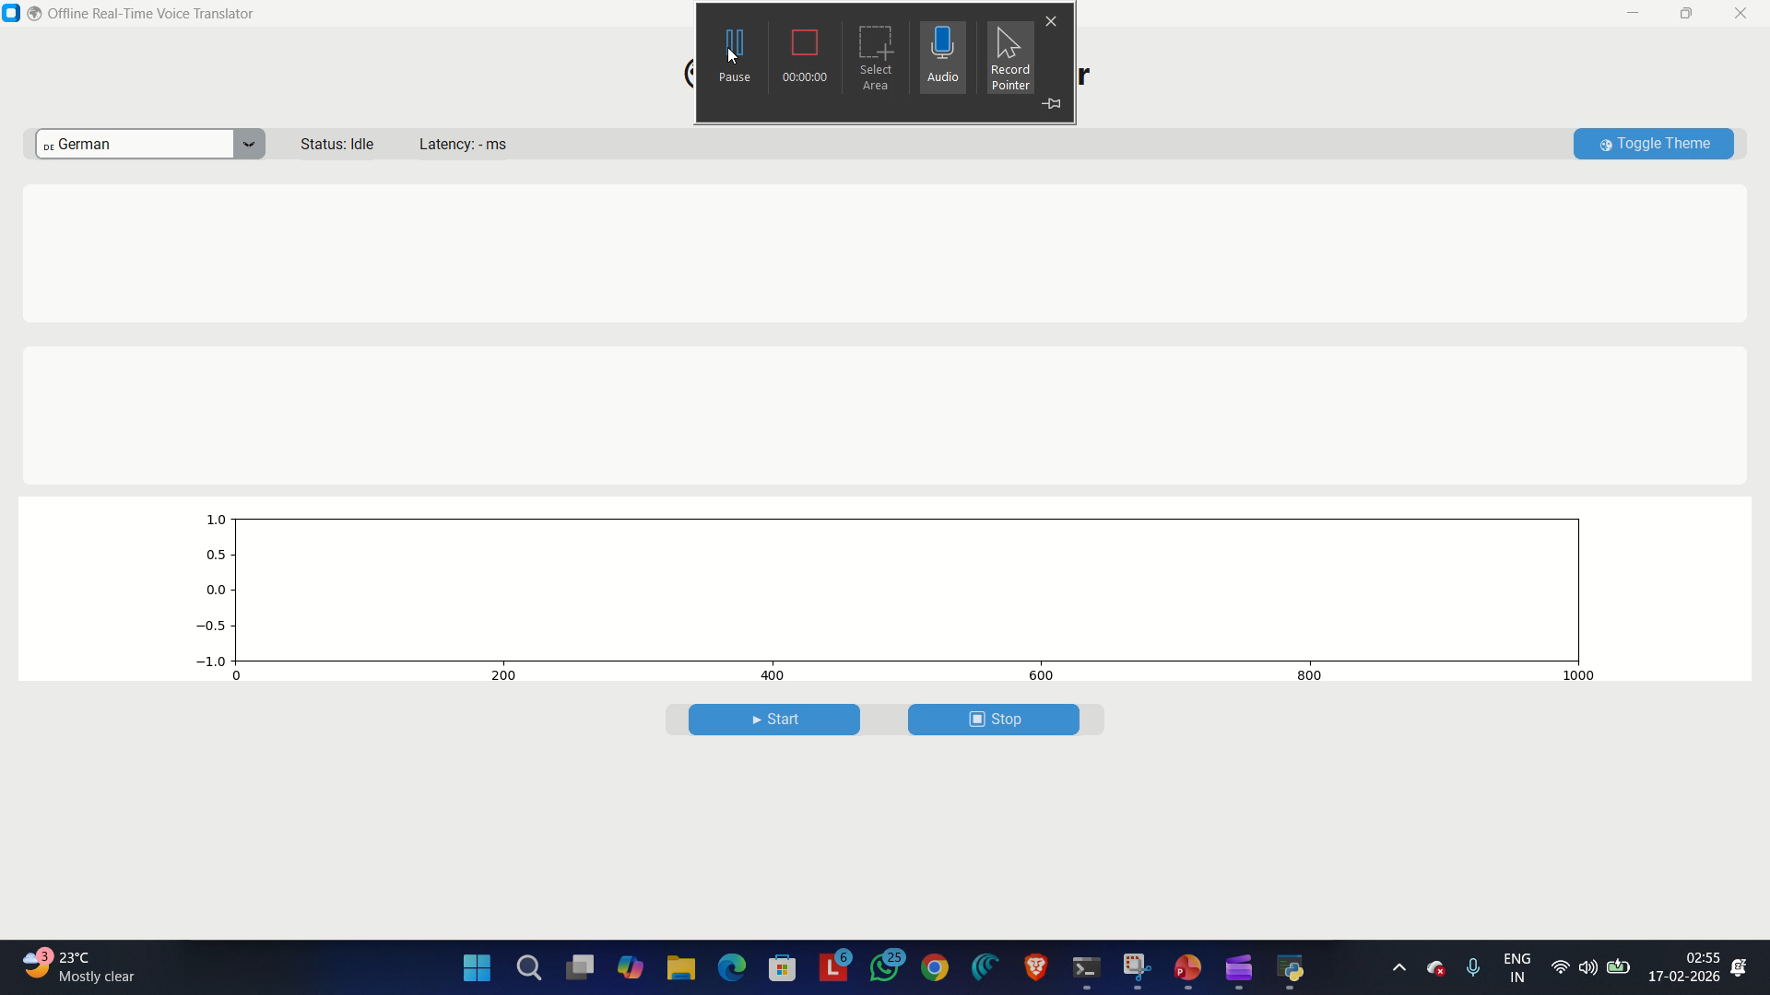
Demo:
Note: In the screen recording, the translated speech output may not be audible due to system audio capture limitations or recording settings. However, during actual real-time operation, the translated speech is clearly audible through the device speakers. The issue is related only to the recording process and does not affect the real-time performance of the system.

Slide 17
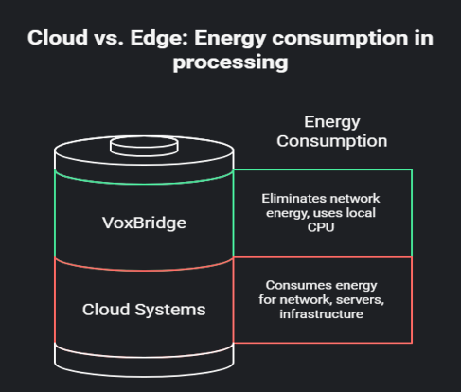
Energy Efficiency :
Cloud systems consume energy for:
Network transmission
Remote server inference
Data center infrastructure
VoxBridge:
Eliminates network energy usage
Uses local CPU inference only
Average CPU power consumption:
15–25 W
Suitable for edge and battery-powered devices

Slide 18
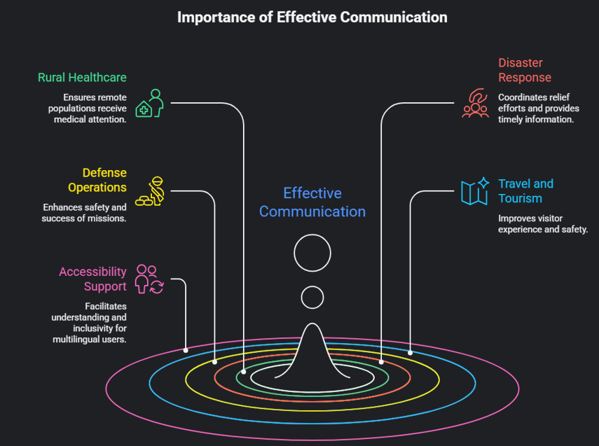
Application :

Slide 19
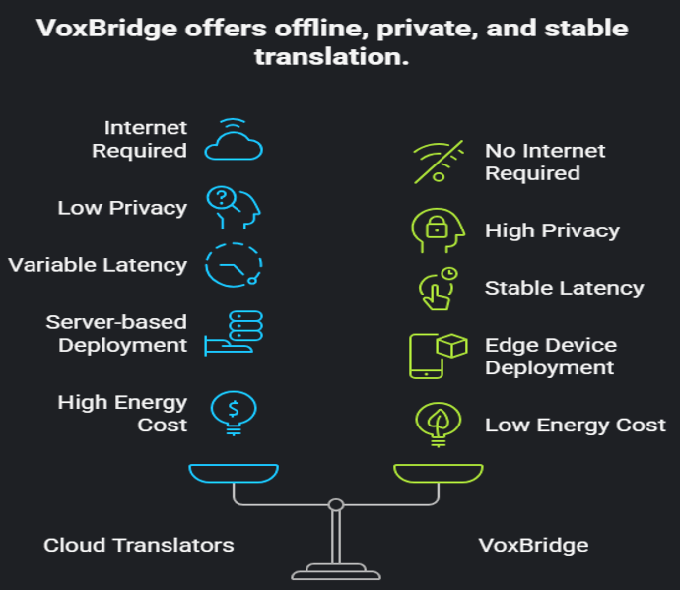
Adavntages Over Cloud Systems :

Slide 20
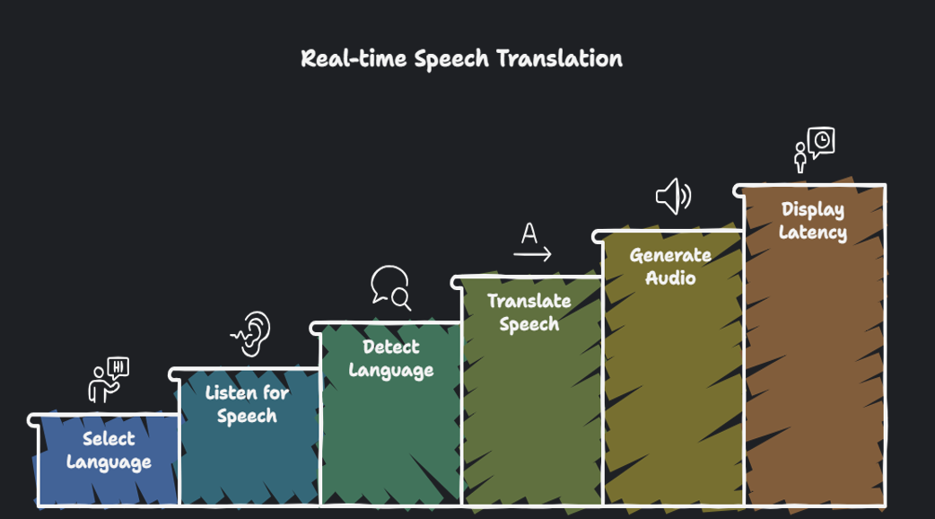
Demonstration Summary :

Slide 21
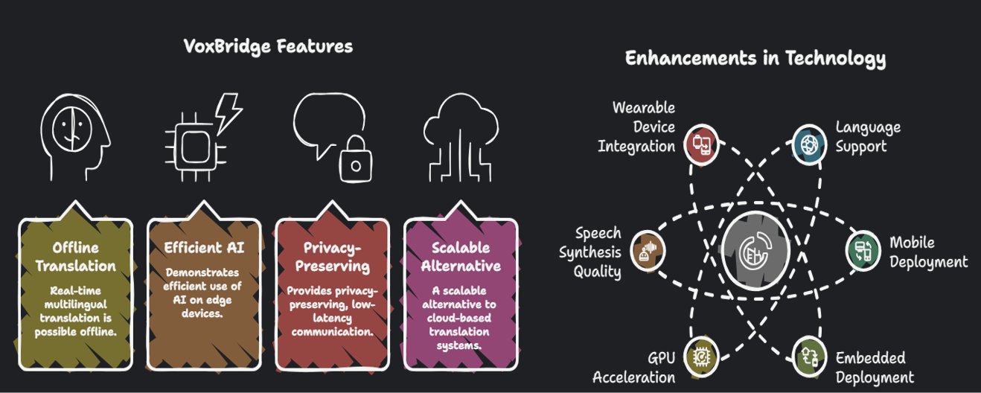
Conclusion & Future scopes :

Slide 22
Thank You

